Slide 1
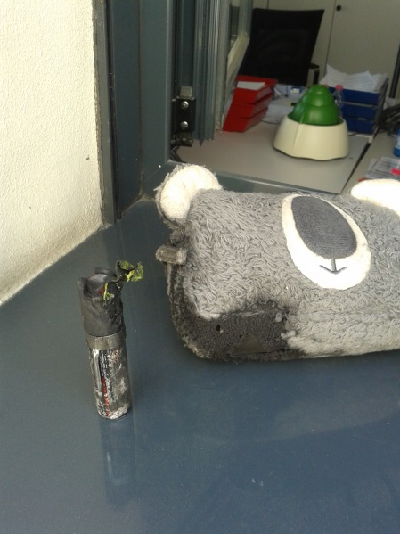

HS&E INCIDENT BULLETIN |  | January - September 2015
Location Country | Type of incident (example: Slip-Trip, Fall from Height, Vehicle , Laceration, Chemical Exposure)
Summary:
Overheating of a pepper spray into a female employee bag for own personal protection developed a fire ignition
Root Causes: | Actions Taken Thus Far: Next Steps
Anomaly of equipment; Gas escape from the aerosol | Action undertaken vs. shop and vs. manufacturer; National association at Aerosol makers informed

